Slide 1


RESOURCE
Patterns using Type
This template is to be used in a flexible way to suit the needs of the presentation. You can add images, colour and graphic elements as needed.

Slide 2
Text in print
In this presentation are some examples of how text can be used as part of a repeating pattern.
Some things to consider when critiquing these patterns:
What type style has been used?
Is the type style fitting for the subject of the print?
How big is it in comparison to other elements in the pattern?
Is the text the main element?
Is the text recognizable or has it been placed in such a way that it doesn’t instantly resemble text?

Slide 3

Kimberly Shrack
Virtu Design Institute Pty Ltd (RTO 40530 - ABN 31 154 273 757) trading as APC Design School
Young Rabbit Pty Ltd (ABN 28 003 381 182) trading as Australian Pacific College | RTO Code: 90396 | CRICOS Provider Code: 01331F

Slide 4

Elena Matveeva
Virtu Design Institute Pty Ltd (RTO 40530 - ABN 31 154 273 757) trading as APC Design School
Young Rabbit Pty Ltd (ABN 28 003 381 182) trading as Australian Pacific College | RTO Code: 90396 | CRICOS Provider Code: 01331F

Slide 5

Virtu Design Institute Pty Ltd (RTO 40530 - ABN 31 154 273 757) trading as APC Design School
Young Rabbit Pty Ltd (ABN 28 003 381 182) trading as Australian Pacific College | RTO Code: 90396 | CRICOS Provider Code: 01331F

Slide 6

Asafeliason
Virtu Design Institute Pty Ltd (RTO 40530 - ABN 31 154 273 757) trading as APC Design School
Young Rabbit Pty Ltd (ABN 28 003 381 182) trading as Australian Pacific College | RTO Code: 90396 | CRICOS Provider Code: 01331F

Slide 7

Adobestock
Virtu Design Institute Pty Ltd (RTO 40530 - ABN 31 154 273 757) trading as APC Design School
Young Rabbit Pty Ltd (ABN 28 003 381 182) trading as Australian Pacific College | RTO Code: 90396 | CRICOS Provider Code: 01331F

Slide 8

Ekaterina Burtseva
Virtu Design Institute Pty Ltd (RTO 40530 - ABN 31 154 273 757) trading as APC Design School
Young Rabbit Pty Ltd (ABN 28 003 381 182) trading as Australian Pacific College | RTO Code: 90396 | CRICOS Provider Code: 01331F

Slide 9
Virtu Design Institute Pty Ltd (RTO 40530 - ABN 31 154 273 757) trading as APC Design School
Young Rabbit Pty Ltd (ABN 28 003 381 182) trading as Australian Pacific College | RTO Code: 90396 | CRICOS Provider Code: 01331F

Slide 10

Ludmila Linhartova
Virtu Design Institute Pty Ltd (RTO 40530 - ABN 31 154 273 757) trading as APC Design School
Young Rabbit Pty Ltd (ABN 28 003 381 182) trading as Australian Pacific College | RTO Code: 90396 | CRICOS Provider Code: 01331F

Slide 11
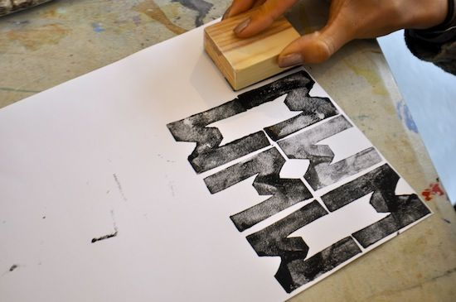
Virtu Design Institute Pty Ltd (RTO 40530 - ABN 31 154 273 757) trading as APC Design School
Young Rabbit Pty Ltd (ABN 28 003 381 182) trading as Australian Pacific College | RTO Code: 90396 | CRICOS Provider Code: 01331F

